Slide 1
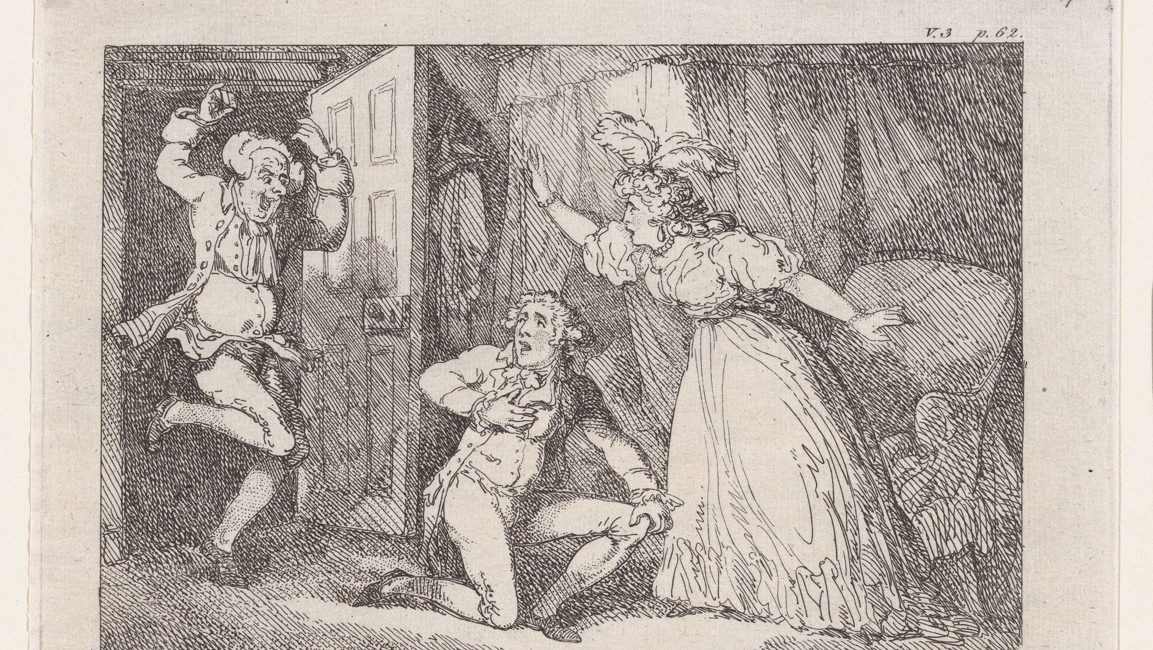
Realism in Tom Jones
Presented by:
***, ***

Slide 2
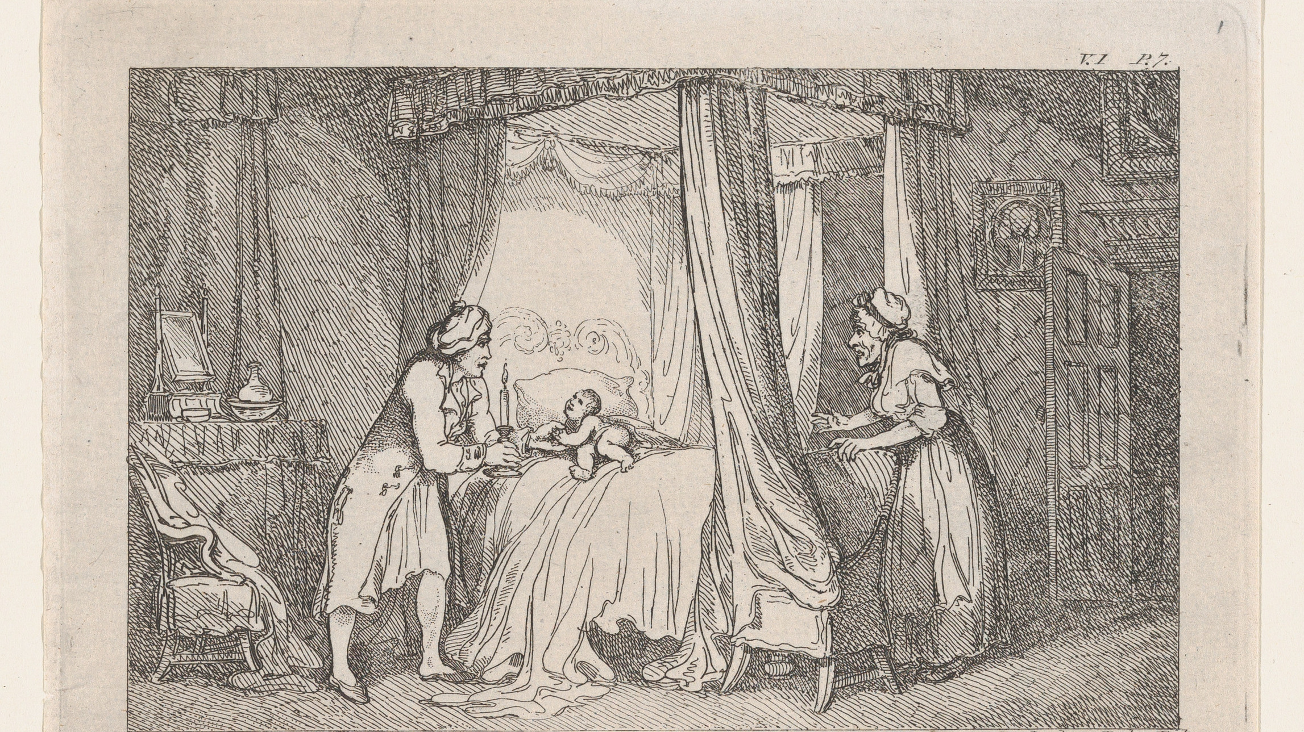
/Content
.Introduction
.Characteristic
.Writing Style

Slide 3
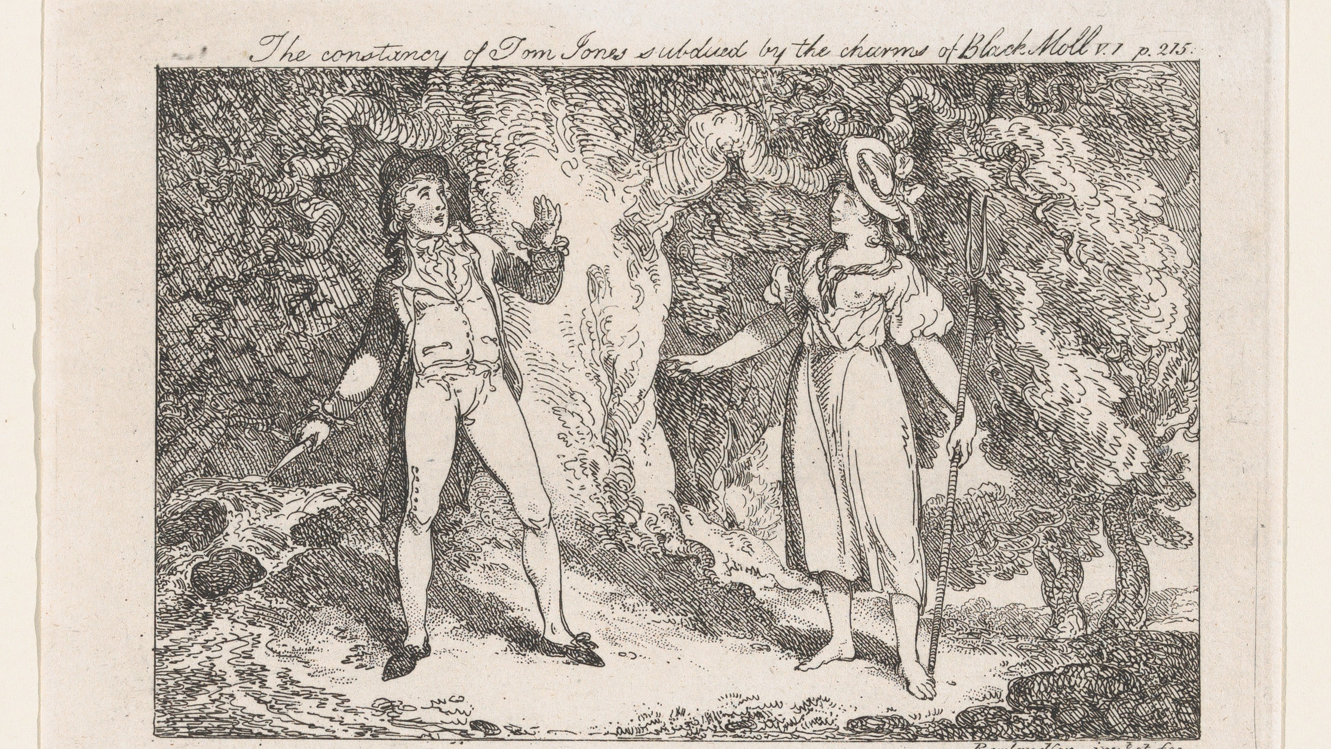
/Introduction
.Author
.Backgrounds

Slide 4
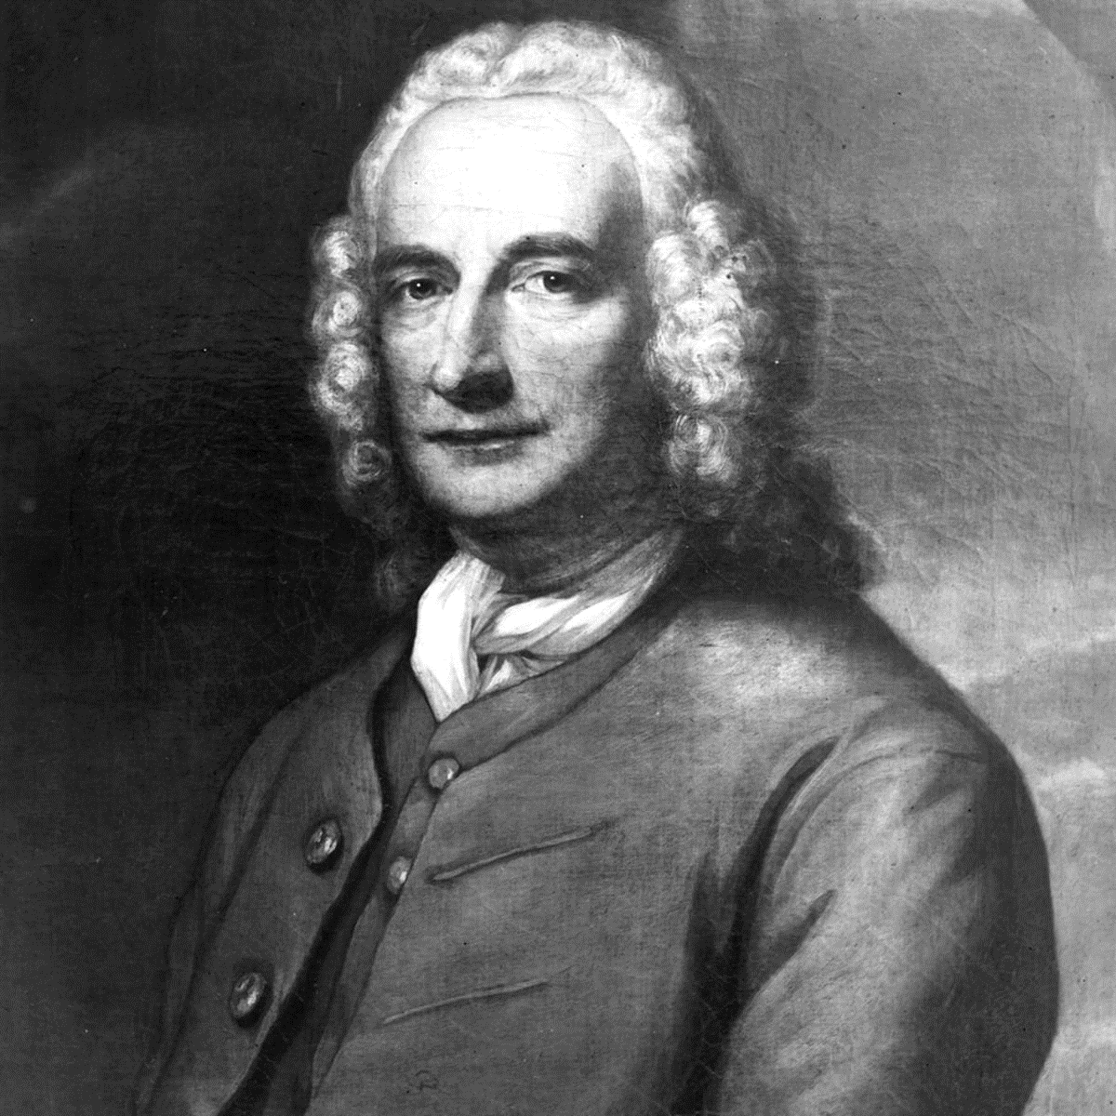
/Author Henry Feilding
The founder of the British realism novel.
One of the most outstanding representative people in the Enlightenment.
His greatest contribution to the literature is his realistic novel.

Slide 5
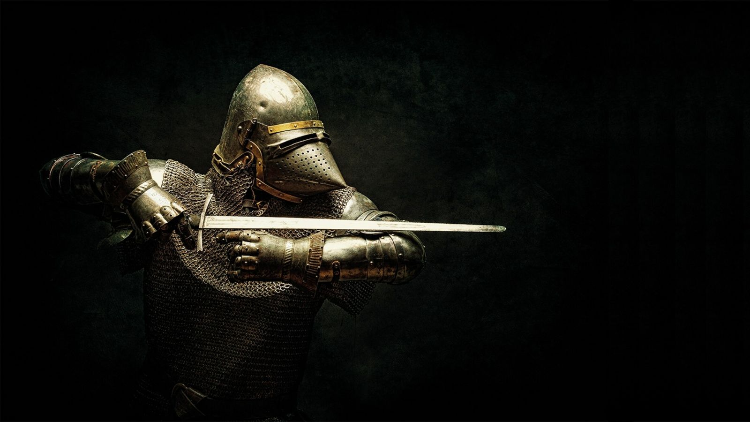
Chivalry literature
Love
glory
religion
/Reflect the ideals of feudal life
/Brave and invincible
/Went through all kinds of magical adventures

Slide 6
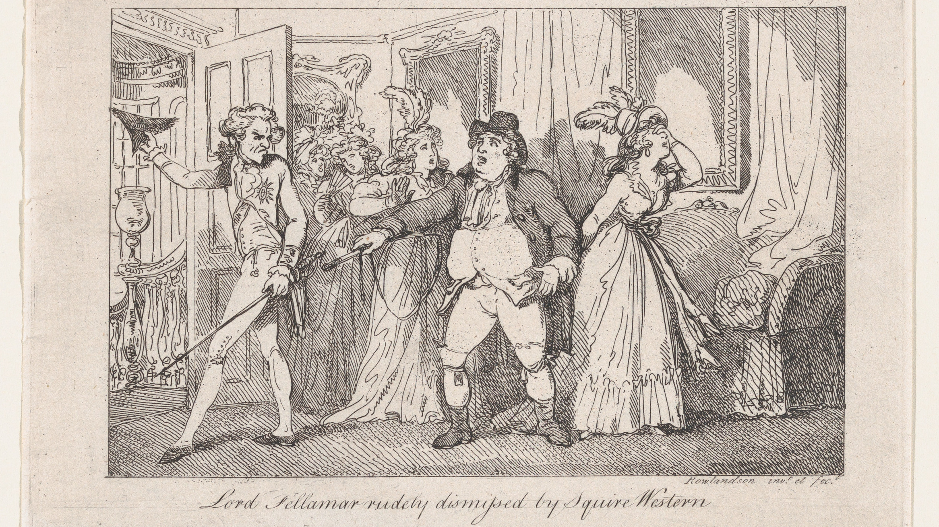
/Characteristic
.Tom Jones
.Mr.Allworthy

Slide 7
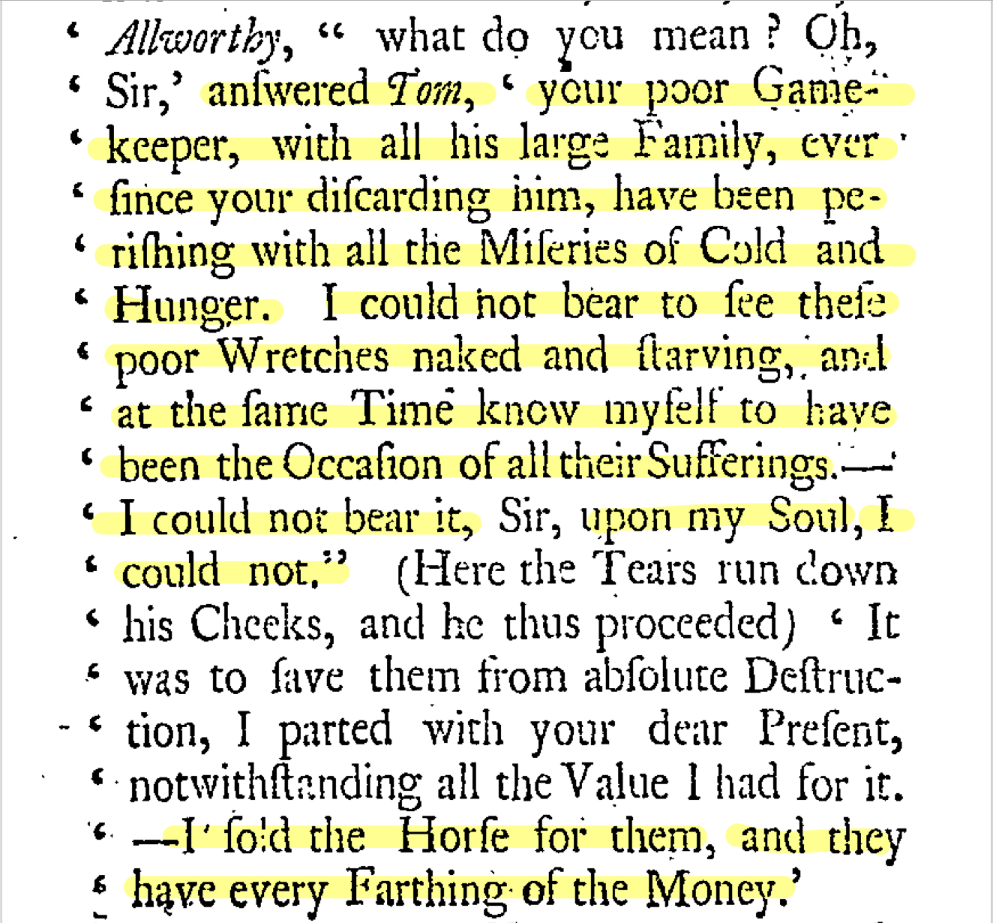
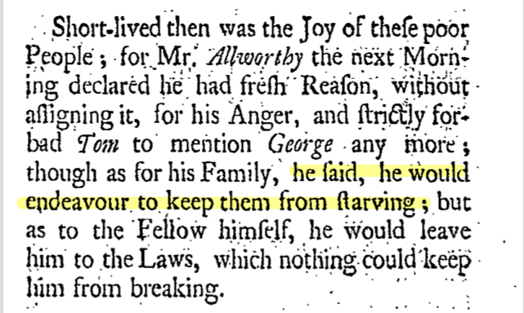
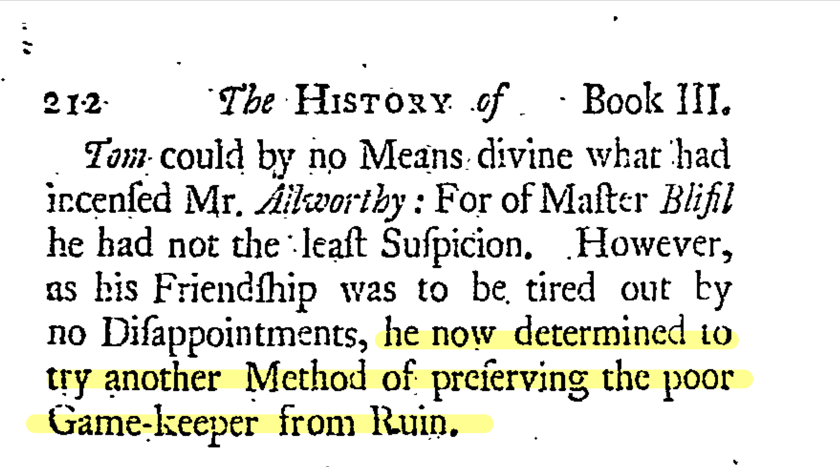
/Tom Jones
Willing
Warm-hearted
But
Susceptible

Slide 8
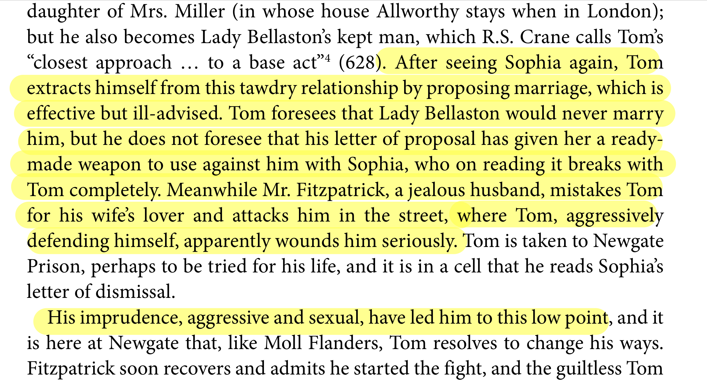
/Tom Jones
Willing
Warm-hearted
Susceptible
Tom could not bear to see the poor Wretches naked and starving.
He sold the horse for them and they had every farthing of money.

Slide 9
/Tom Jones
Willing
Warm-hearted
Susceptible
The poor Game-keeper was condemned and had no opportunity to defend himself.
Tom determined to attempt to preserve the poor Game-keeper from ruin.

Slide 10
/Tom Jones
Willing
Warm-hearted
Susceptible
But in London, he had something with Lady Bellaston.
Despite the fact that his love to Sophia was faithful, he still might have an affair with other women when being tempted.

Slide 11
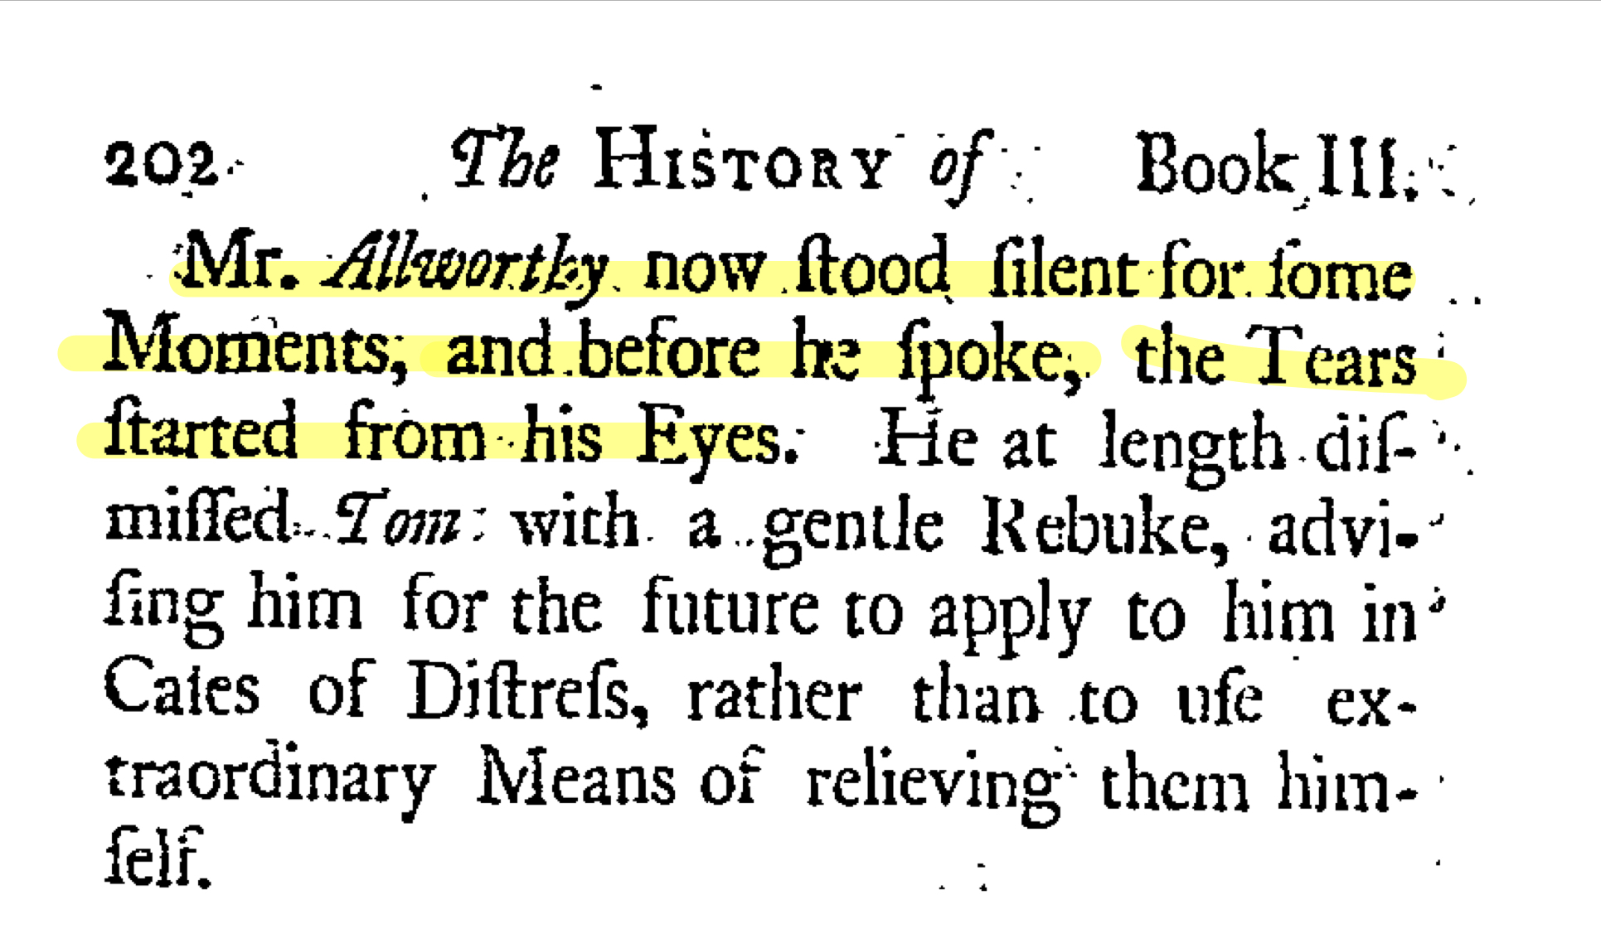
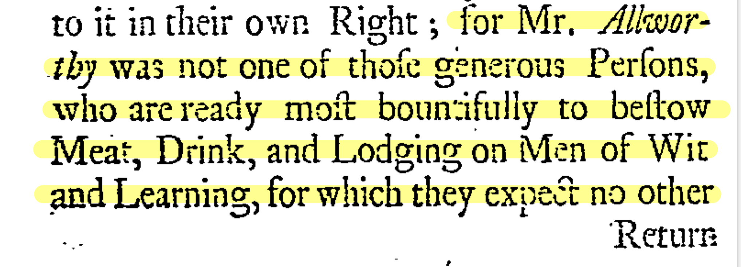
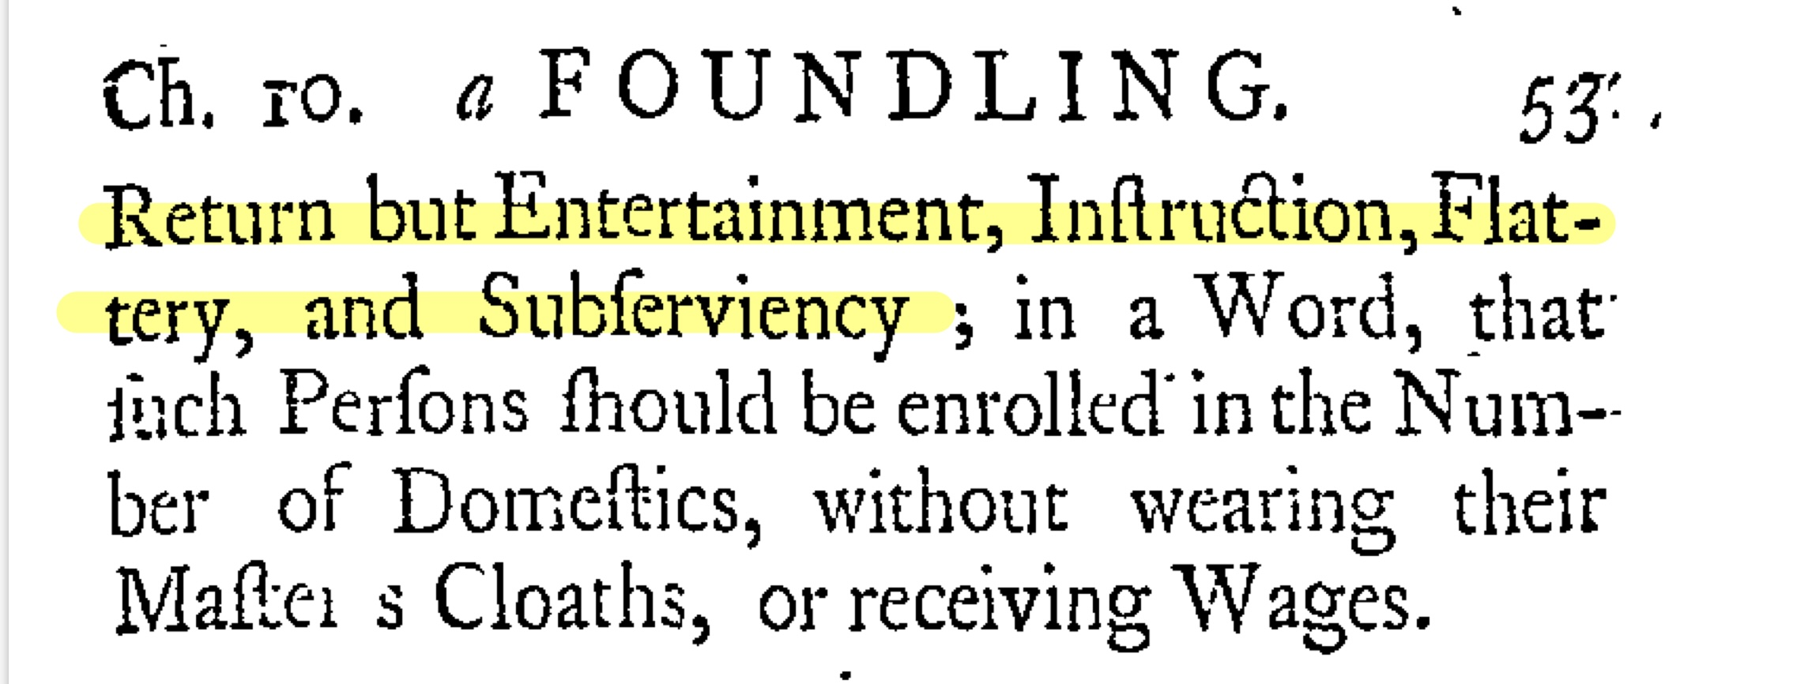
/Allworthy
Generous
Warm-hearted
Easy to be confused by flattery
But

Slide 12
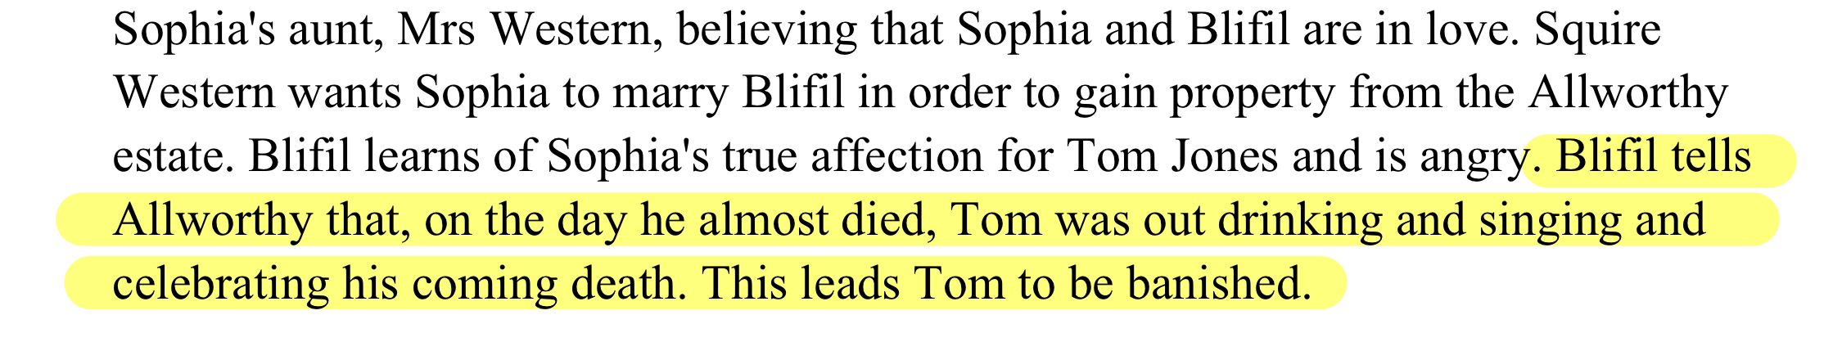
/Allworthy
Generous
Warm-hearted
Easy to be confused by flattery
When Tom relieved and helped the poor Wretches far from starving, Mr. Allworthy was touched by Tom.
He had the same idea as Tom and also got a warm heart in his body.

Slide 13
/Allworthy
Generous
Warm-hearted
Easy to be confused by flattery
Mr. Allworthy was always generous and ready to offer food to others.
He helps others from the bottom of his heart.

Slide 14
/Allworthy
Generous
Warm-hearted
Easy to be confused by flattery
Mr. Allworthy believed what Blifil said and expelled Tom.
Mr. Allworthy’s flaw which is that he was easy to lend a ready ear to slanders and difficult to know black from write.

Slide 15
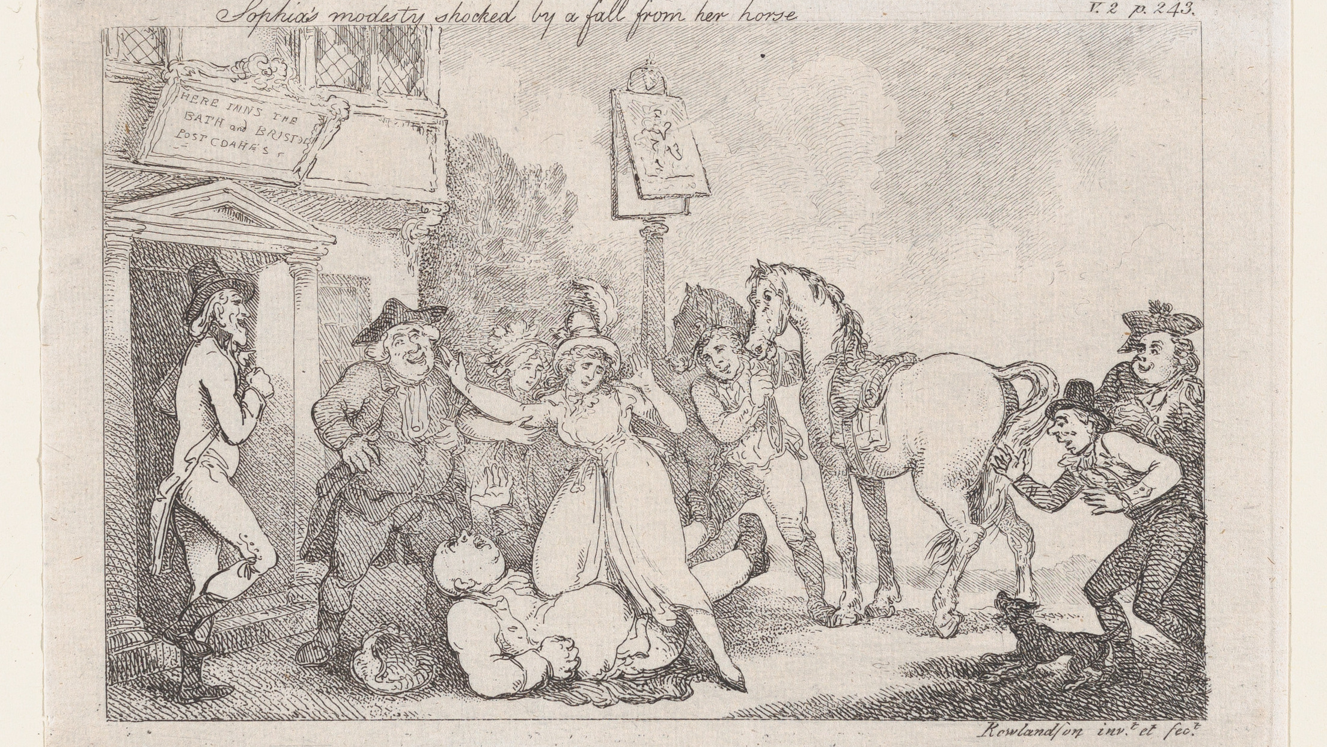
/Writing Style
.Prologue
.True Name

Slide 16
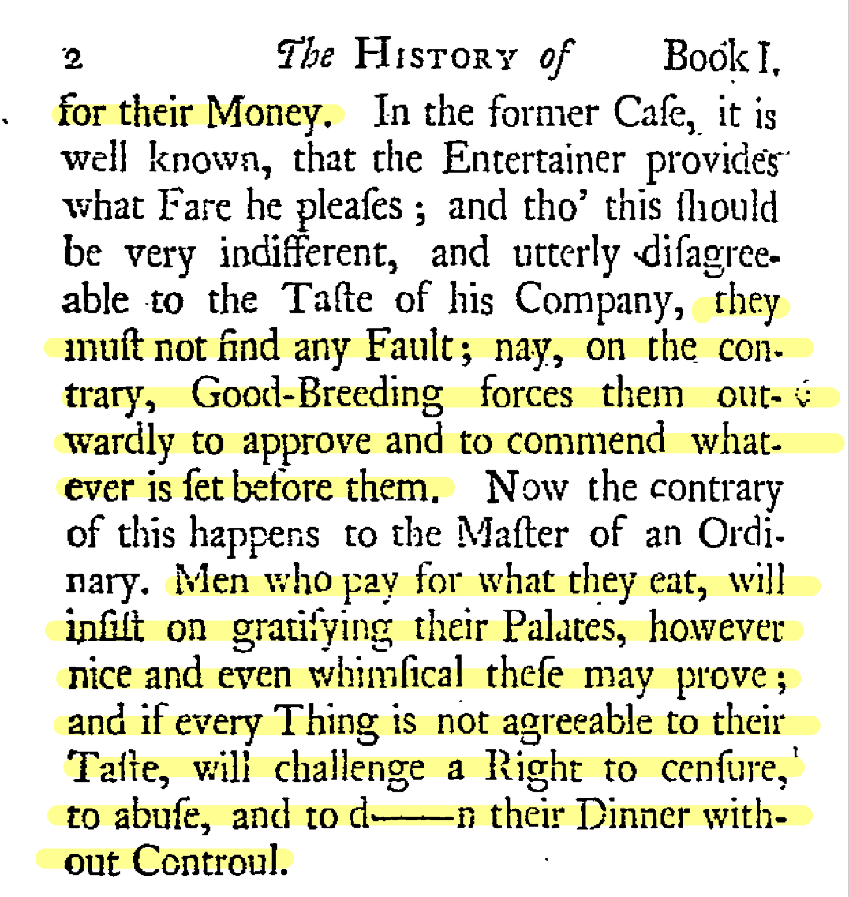
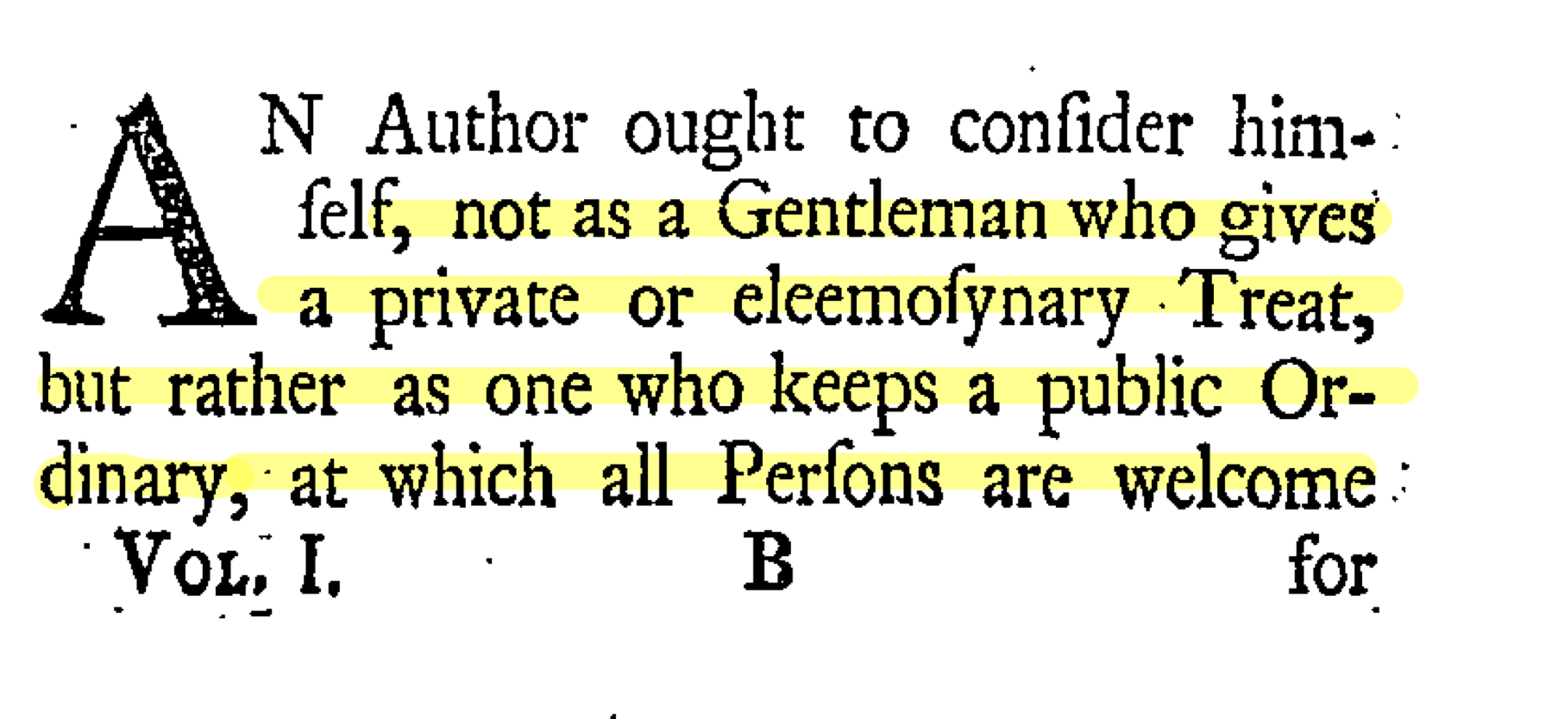
/Prologue
The author ought to consider himself as a restaurant owner, not a charity.

Slide 17
/Prologue
unpleasant!
Poor taste!
Salty!
unpalatable!
Too hot!
Disgusting!
Poor taste!
unpleasant!
Not tasty!
Inappetence!
Salty!
Too hot!
unpalatable!
unpalatable!
Inappetence!
/It is difficult to cater for all tastes.

Slide 18
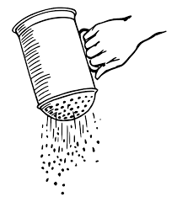
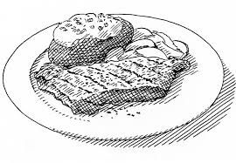
/Prologue
#Add seasoning

Slide 19
/Prologue
#Add seasoning
too much

Slide 20
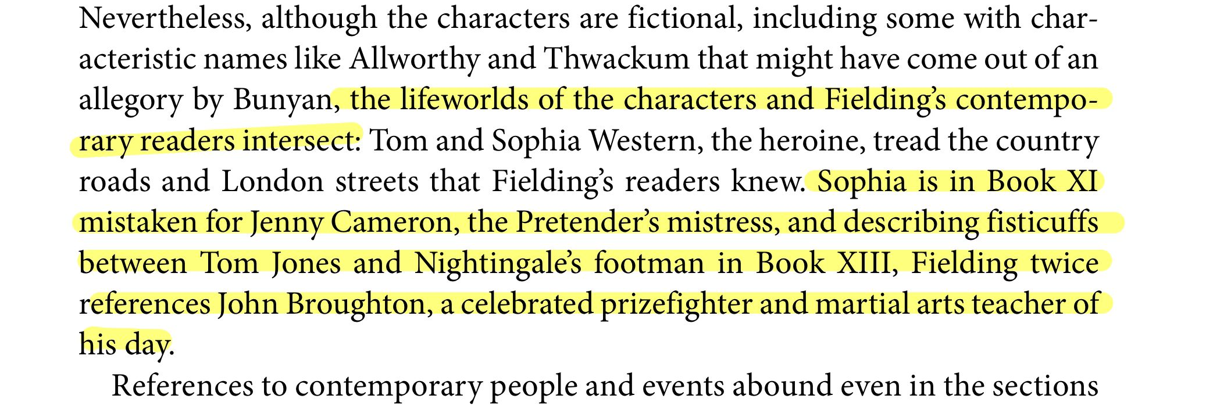
/True name
To be honest, adding in real characters to a novel can be a great way to add a real sense of reality to a novel

Slide 21
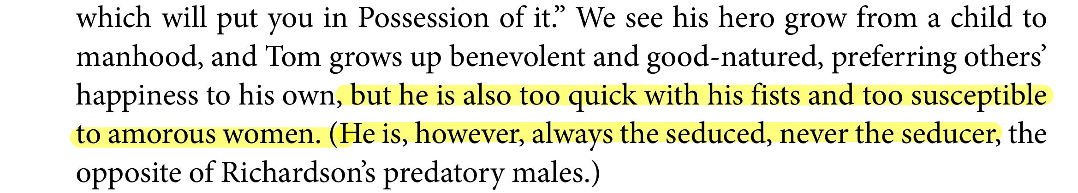
something
S
interesting
Same reason
#Why Tom was designed like this?
Tom Jones
Mr.B

Slide 22
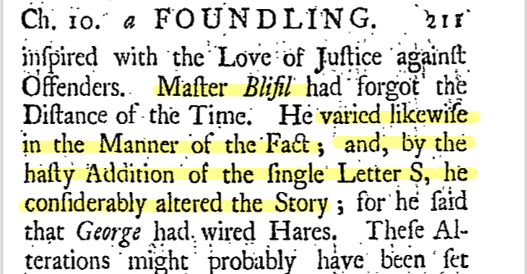
something
S
interesting
#Why Bilfil was designed like this?

Slide 23
something
S
interesting
#Why Bilfil was designed like this?
The author hates people who will do anything to get an advantage and are hypocritical. So this character was designed to be overthrown.

Slide 24
something
S
more
interesting
Will he still be able to marry Sophia?
#What if Tom is truly the maid's child
Will he die in jail?
Will he still eventually inherit the property?

Slide 25
something
S
more
interesting
“ It is because of his flaws that his virtues are so precious. ”

Slide 26
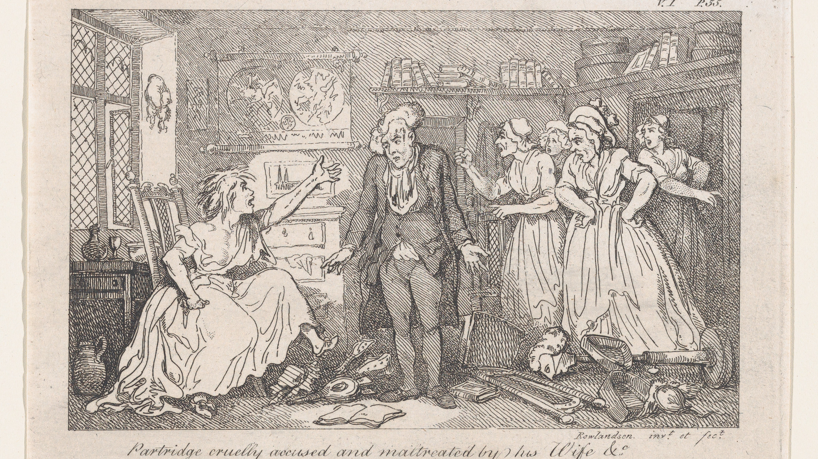
/Thanks

